Slide 1
Solar Generation System
CLO_3

Slide 2
The photo-voltaic effect was first identified in 1839 by French physicist Alexandre-Edmond Becquerel (not Henri, his dad).
Process in a nutshell:
- Photons hit semiconductor surface.
- If energy level is just right, it bumps electrons from valence position
up to a conduction level.
- Electrons in conduction level travel and make electricity…

Slide 3
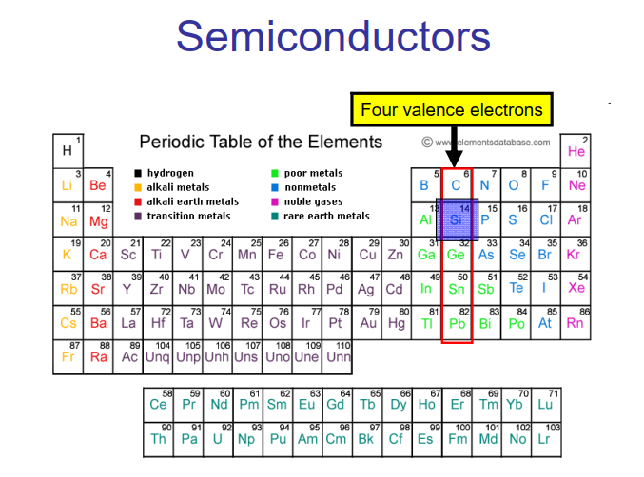

Slide 4
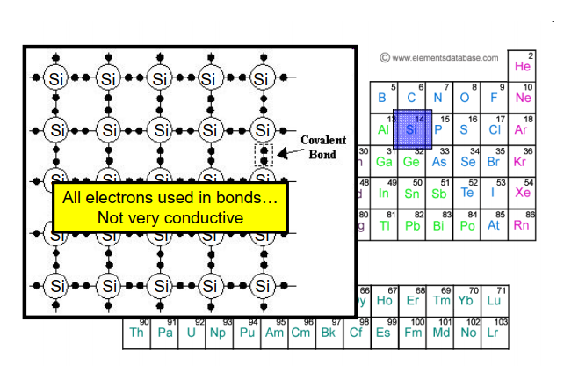

Slide 5
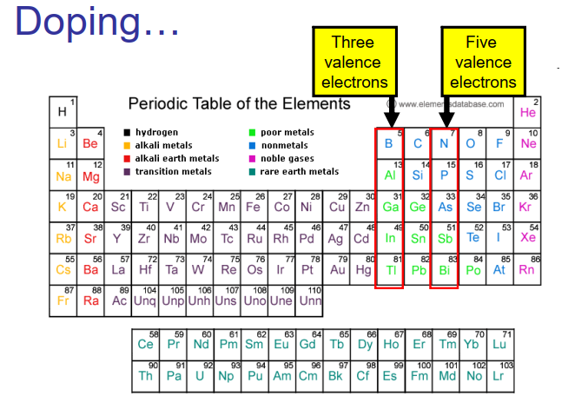

Slide 6
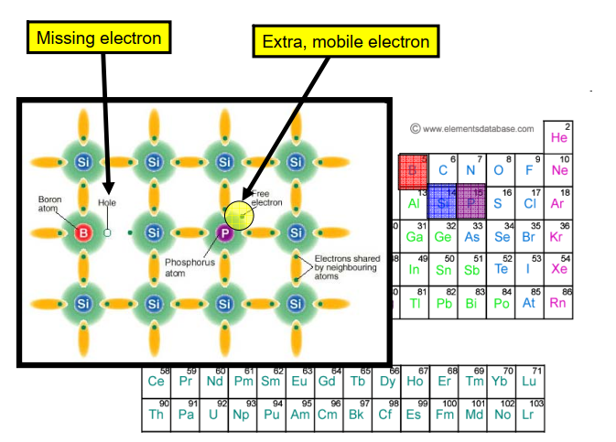

Slide 7
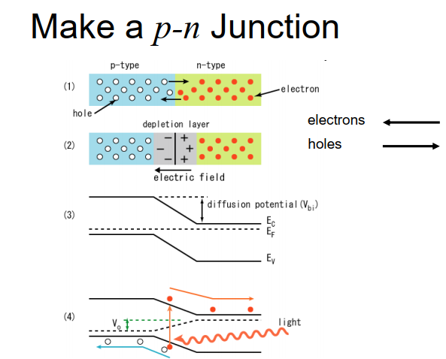

Slide 8
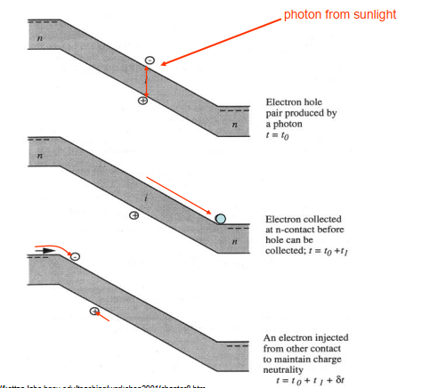

Slide 9
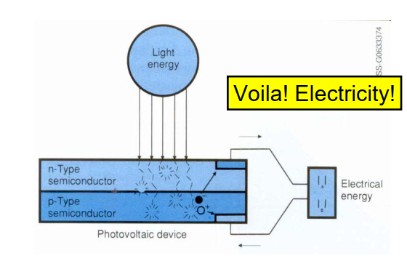

Slide 10
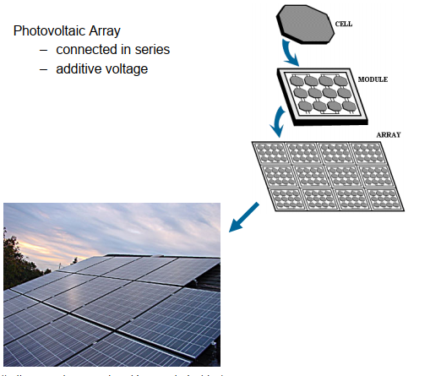

Slide 11
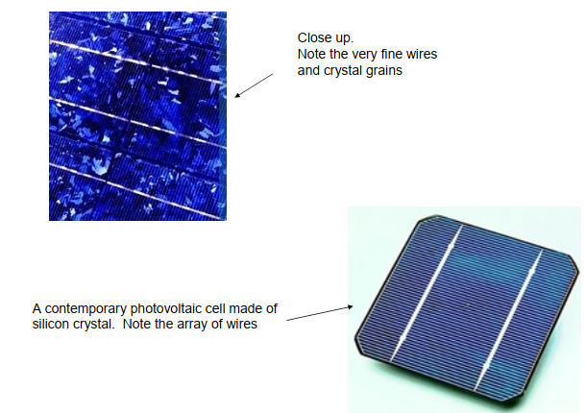

Slide 12
In Step 1, we observe a p-n junction where the n-type material has an excess of electrons and the p-type material has excess holes in the absence of light.
• In Step 2, the excess electrons present in the p-type material combine with the holes in the interface region due to opposite charge attraction and create the depletion region observed in Step 2 of Figure 3. This depletion region is well defined and it occurs only at the interface of the P-N junction.
• In Step 3, when light shines on this semiconductor device, mobile electrons are created as a result of the photoelectric effect. The energy to mobilize electrons come from the photons in the light. Some electrons accelerate towards the n-type material or, said differently, some holes accelerate towards the p- type material

Slide 13
In Step 4, the acceleration in the previous step forms a high concentration of mobile electrons in the n-type semiconductor and mobile holes in the p-type semiconductor.
In Step 5, by merely connecting the p-type and the n-type with a conductor, a unidirectional flow of electrons is observed across the p-n junction.

Slide 14
The n-type material has greater conductivity than intrinsic material because electrons easily enter the conduction band by thermal excitation. Likewise p-type has holes that easily enter the valence band. The Fermi level is a descriptive and analytical method of explaining this (Figure 7.3). It is the apparent energy level within the forbidden band gap from which majority carriers (electrons in n-type and holes in p-type) are excited to become charge carriers

Slide 15
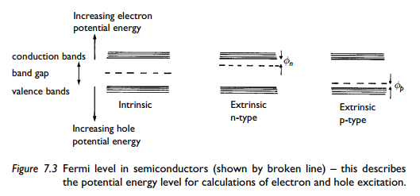

Slide 16
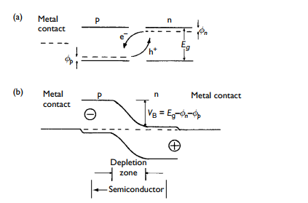

Slide 17
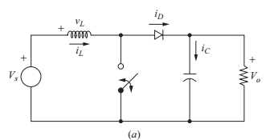
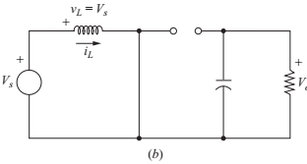
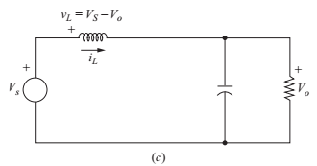
Boost Converter Design

Slide 18
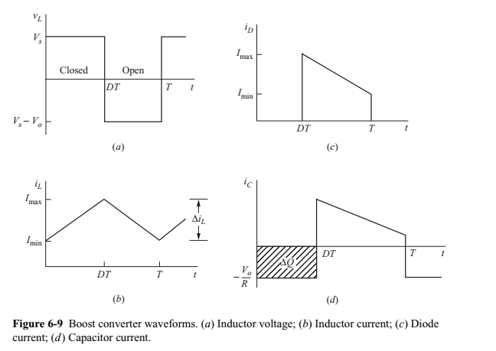

Slide 19
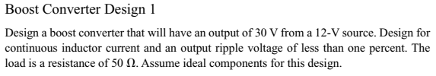


Slide 20

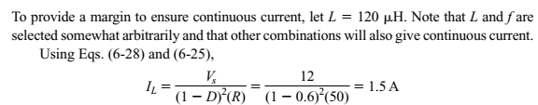

Slide 21
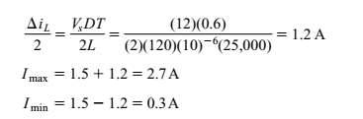


Slide 22
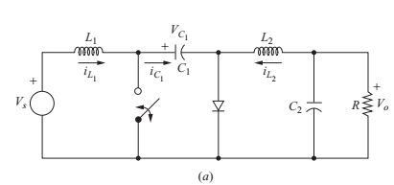
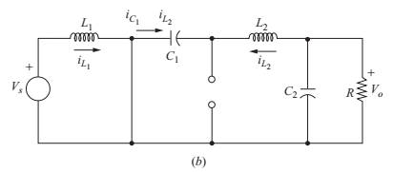
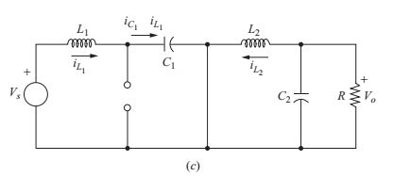
Cuk Converter:

Slide 23

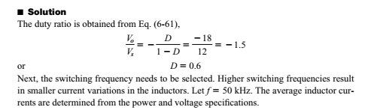

Slide 24

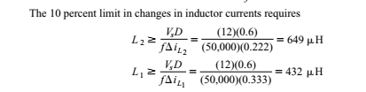

Slide 25
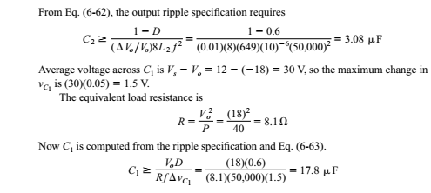

Slide 26
Maximum Power Point Tracking
The efficiency of PVPG system is the product of PV panel conversion efficiency, MPPT efficiency, and the inverter efficiency. Therefore, improving the MPPT efficiency is of great significance for increasing the system efficiency and reducing the cost.
Under different radiation levels and PV cell temperatures, the maximum output power points of photovoltaic cells are different, as shown in Fig. 1.6. Fig. 1.6a shows the current-voltage (I-U) curves of a PV module, and its power-voltage (P-U) curves are shown in Fig. 1.6b, where S represents the radiation level, and I, U and P are the output current, voltage, and power of a PV module, respectively.
In order to track the maximum output power, some measures have to be taken to automatically follow the changes in environmental conditions. MPPT technology has been proposed in response to this issue [3].

Slide 28
Conventional MPPT algorithms include open-circuit voltage method, short circuit current method, perturbation-observation method, incremental conductance method, etc. [6, 7].
Recently, some intelligent tracking algorithms have appeared, such as fuzzy control algorithms, and neural network algorithms. Several widely used MPPT algorithms are induced as following.

Slide 29
Perturbation and Observation Method
The perturbation and observation method finds the maximum power point by increasing and decreasing the output voltage of PV strings with a small step based on measuring and comparing power variations [8, 9].
Briefly speaking, the algorithm keeps adjusting the output voltage with the same step if the output power variation is positive; otherwise, changing the step with opposite direction. Obviously, this algorithm belongs to hill-climbing method, and depends on the P-U

Slide 30
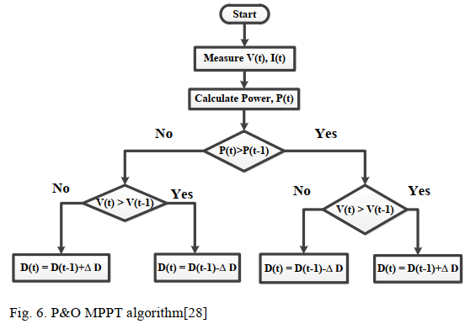
P&O Method

Slide 31

Incremental Conductance Method
The increment conductance method essentially belongs to hill-climbing method too [10]. It is proposed based on that the derivative of the PV cell output power to voltage is zero at the maximum power point. Therefore,

Slide 32
The change of the control signal is decided by detecting instantaneous conductance G and conductance increment ΔG of the PV string output and comparing these two values with zero.
The outstanding advantage of the incremental conductance method is that the amplitude of its voltage oscillation is relatively small.
However, the determination of the voltage increment step is much complicated.
For instance, the tracking error will be large if the step is too large; on the contrary, the tracking speed will be slower. On the other hand, the incremental conductance method requires high accuracy and response time of the sensors and detection circuits.

Slide 33
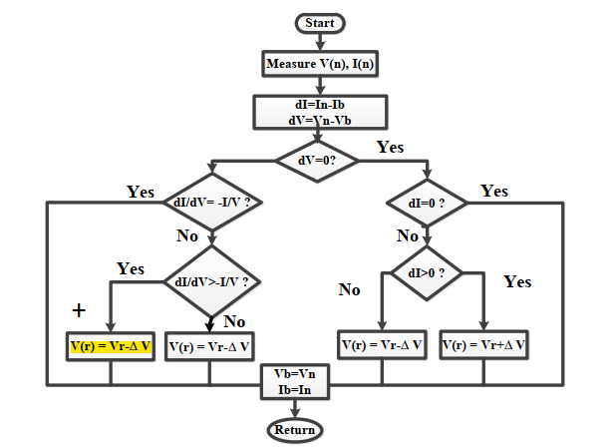
Incremental Conductance

Slide 34
Intelligent Algorithms
In practical applications, complex environments such as local shadows often make the P-U characteristic curves of PV arrays present multiple power pick points. For conventional direct MPPT control methods based on sampled data, such as abovementioned perturbation and observation method, and incremental conductance method, etc., they tend to be trapped in local peak points and cause serious power mismatch.
As a consequence, the local peak points not only lose energy but also damage PV cells because of hot spot phenomenon. Therefore, how to track the global maximum power point in the case of local shadows is a critical issue needed to be solved.

Slide 35
Fuzzy algorithm
The essence of fuzzy logic control is a logical reasoning system based on the experience and intuition of the equipment operator, which is suitable for some systems whose mathematical models are difficult to build. For non-linear output characteristics of PVPG systems affected under factors of temperature and irradiance, a suitable control fuzzy rule table can be formulated based on the PV output characteristics and operating experience.
The working voltage can be fast and accurately stabilized at the maximum power point [13-17]. Because traditional fuzzy logic control is not suitable for the global MPPT problem under local shadows, Hopfield neural network can be used to optimize the fuzzy logic controller so that it has a dynamic fuzzy rule table [17]; or using immune algorithm to optimize fuzzy logic control, for instance, combined with the double advantages of fuzzy logic theory and artificial immune theory, the global maximum power point can be achieved under local shadows [16]

Slide 36
Neural Network Algorithm
Neural network technology is a kind of control technology that mimics human thinking. It does not depend on the mathematical model of the controlled process, features strong anti-interference ability and black box learning ability.
Therefore, it is quite suitable for the MPPT function of PVPG systems [18, 19]. However, the learning mode of the neural network algorithm requires long-term training, and the relationship between input and output data is difficult to be expressed.

Slide 37
The explanation of MPPT Techniques are in research Papers.
More details examples of boost and Cuk Converters are from McGraw Hill book

